Slide 1


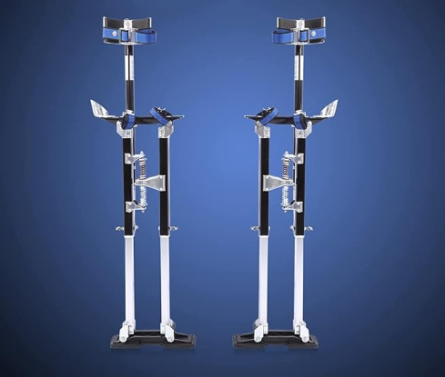
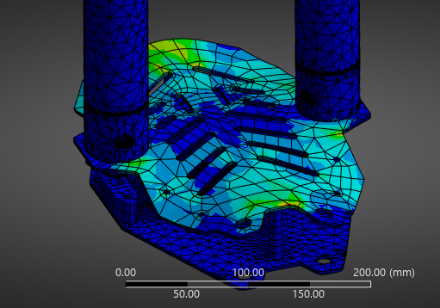
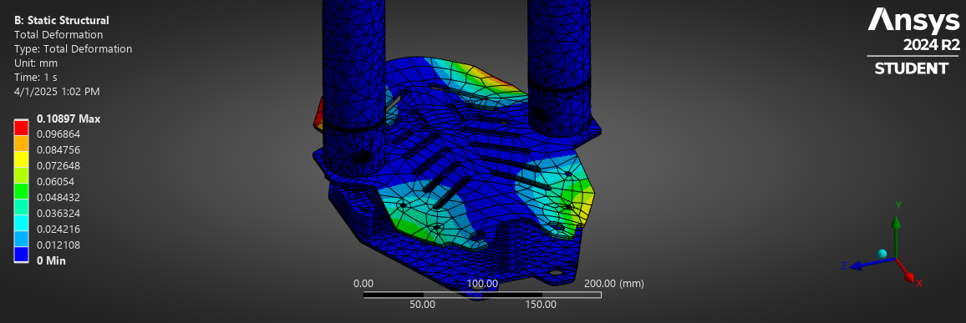
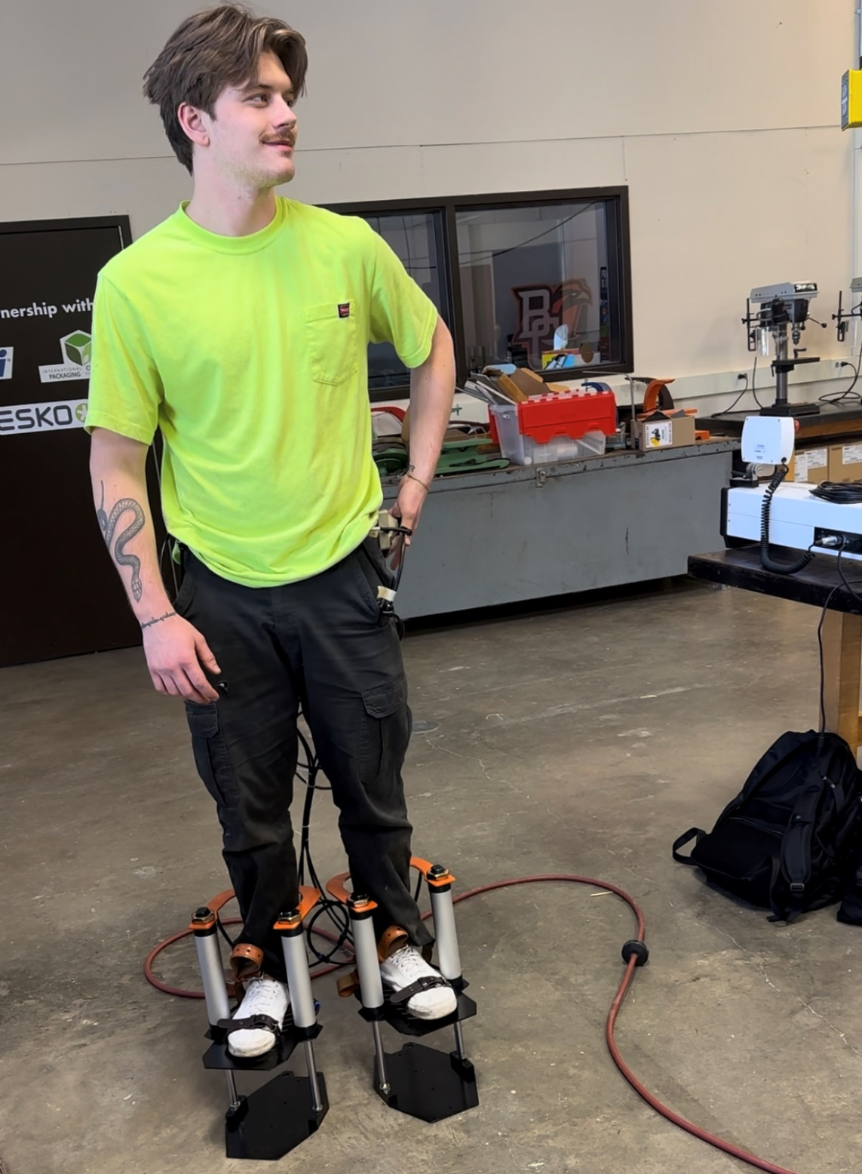
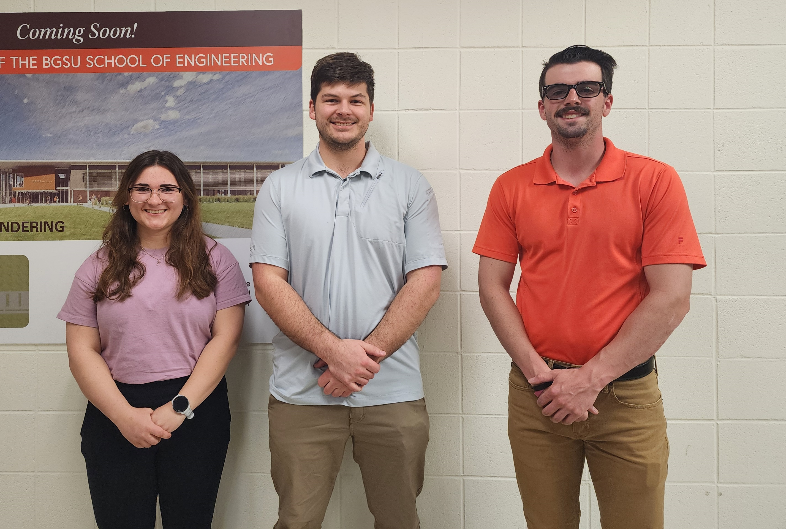
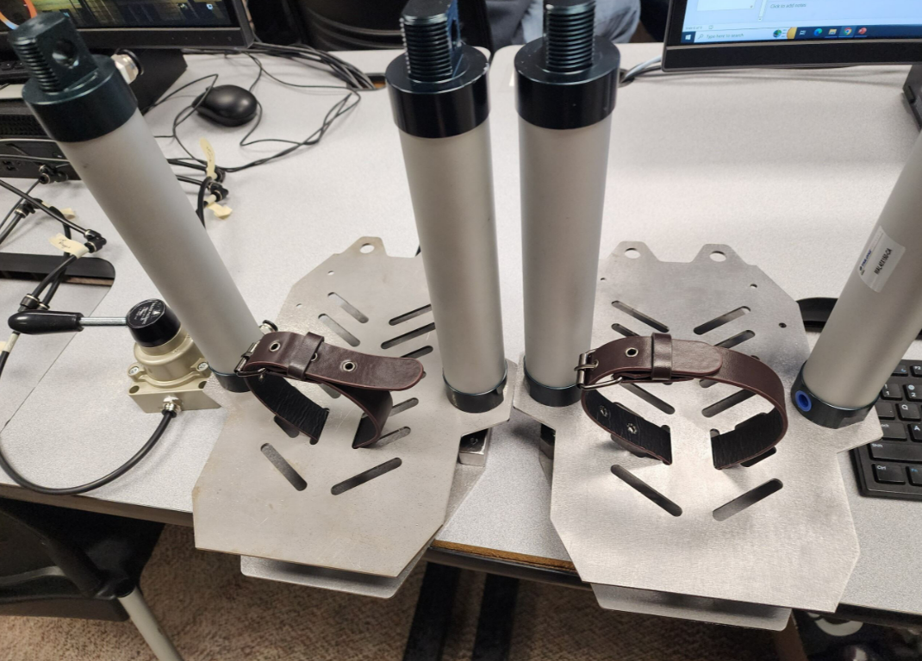
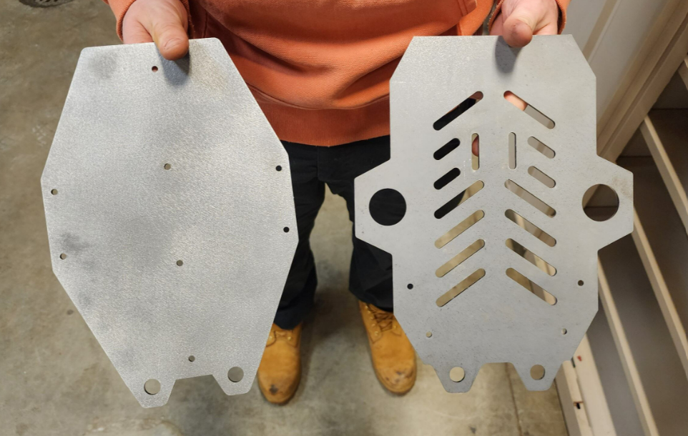
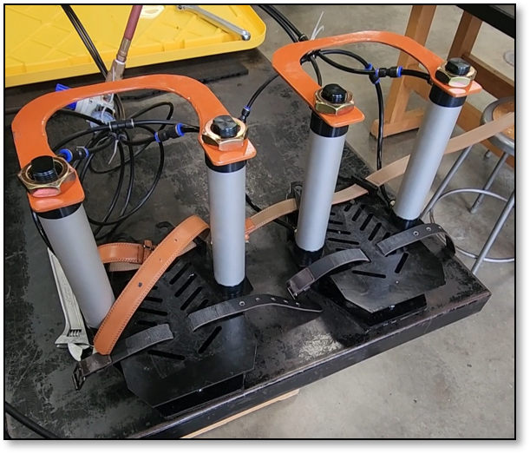
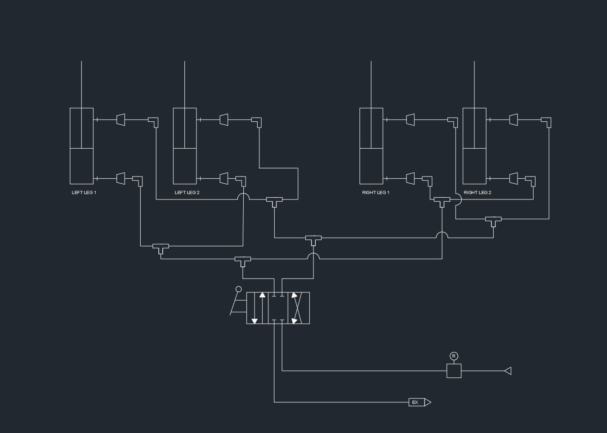
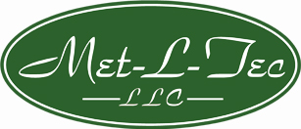

Air Ladder Cameron McClellan, Hannah Obert, Aidan Downs, Brendon Kolkemeyer
Abstract
Methodology and Implementation
Results and Discussion
Conclusion
Given the number of ladder accidents each year we sought out to find a quick and safe way to access higher areas, without the need for a big and bulky ladder. With our product, we plan to make a pair of boots that will attach to each foot that can manually be controlled by the operator to raise and lower themselves. Our compact, portable, and light design would allow a worker to walk around while raised and lowered. This boot would be sturdier than a ladder as well, given that it attaches to the operators' feet with three different leather straps. The implementation of our project in the construction industry could eliminate any hazards that occur when a worker is on top of a traditional ladder. Our product will also be easy to remove, just unclip the controller from your tool belt and unbuckle the boots. We intend to make the boot as ergonomic as possible, this way the worker won't feel any discomfort while using our product.
Below in Figure 1, is an image that our design was based off. As already mentioned, currently what most construction sites use as a method of reaching elevated spaces are these stilts. They do have height adjust but would require the worker to take their weight off them. The implementation of Air Ladder would eliminate this timely and extra step.
In the design phase of this project many considerations were made but given the project timeline and attempting to stick to cheaper options we went with the design shown today.
Some of these future design considerations being:
Shafts mounted on the back of the plates for extra support and stability
A quicker method for removing the operator's foot like snowboard boot clips
Lighter more compact design to remain safe, but give the operator more comfort, use of aluminum or carbon fiber
Vest mounted controls for raising and lowering the operator rather than the lever action valve
With these future considerations in mind, we are still overall impressed with the progress we able to make throughout the semester.
In the design phase of the project, our plan was to keep each boot weight under 25 lbs. per foot. Using the built in Mass Evaluation tool in SolidWorks. We were able to find that our design would be exactly where we wanted our goal weight to be,
Ideally, we would want to reduce our products weight and add in some more stability. However, as designed our concept has proven to work with not only the load of our operator, but a total load of 680 lbs. @ 100 psi.
References
Project/Prototype Images
Pneumatics Reference: Lydey Automation
Jake Lydey helped with pneumatic cylinder questions
Met-L-Tec LLC: Provided sheet metal cutouts
Equivalent Stress Analysis
Project Team
Total Deformation Analysis
Figure 1
Introduction
Currently, the construction industry has a static version of these stilts for drywallers to walk around on. However, this design isn't too suitable for workers who need to consistently raise from floor level to the ceiling/ working level. Air Ladder, would eliminate the time and hassle needed for removing the static version of these stilts and putting them back on after grabbing what you need from the floor. Given that almost every construction site has a portable air compressor we felt that pneumatics was the cleanest and safest route for our vertical travel.
Base Plates
Mid-Term Progress
Acknowledgements
Pneumatic Schematic
Final Product

